Slide 2
Today’s Lecture.
What is dynamic programming?
Elements of dynamic programming.
Dynamic solution for Matrix chain multiplication.

Slide 3
What is dynamic programming?
Definition: An algorithmic technique in which an optimization problem is solved by caching sub problem solutions rather than re computing them.
Similar to divide & conquer, but sub-problems not independent.
Programming refers to the tabular method.(not writing code)
Solution to each sub-problem is saved, rather than recomputed.

Slide 4
Optimization Problem
Definition: A computational problem in which the object is to find the best of all possible solutions.
More formally, find a solution in the feasible region which has the minimum (or maximum) value of the objective function.

Slide 5
When can we use dynamic programming?
Dynamic programming computes recurrences efficiently by storing partial results.
Thus dynamic programming can only be efficient when there are not too many partial results to compute.

Slide 6
Elements of dynamic programming.
Optimal substructure.
Overlapping sub problems.

Slide 7
Optimal substructure.
If optimal solution to the problem contains within it’s optimal solutions to sub problems,Then we say that the problem exhibits optimal substructure.

Slide 8
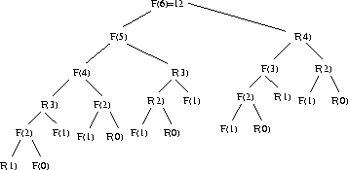
Overlapping Sub problems.
When recursive algorithm revisits same sub problem over and over again, then we say that the optimization problem has overlapping sub problem.

Slide 9
Matrix-chain Multiplication
Matrix multiplication.
What is Parenthesization.
Optimal parenthesization.
Recursive solution for optimal parenthesization.
Dynamic programming solution.

Slide 10
Matrix-chain Multiplication
Consider the matrix multiplication procedure
MATRIX_MULTIPLY(A,B)
1. if columns[A] ≠ rows[B]
2. then error "incompatible dimensions”
3. else for i ← 1 to rows[A]
4. do for j ←1 to columns[B]
5. do C[i,j] ←0;
6. for k ← 1 to columns [A]
7. do C[i,j] ← C[i,j]+A[i,k]*B[k,j];
8. return C

Slide 11
Scalar Multiplication
    The time to compute a matrix product is dominated by the number of scalar multiplications in line 7.
    If matrix A is of size (p×q) and B is of size (q×r), then the time to compute the product matrix is given by pqr.

Slide 12
Paraenthesization
    Example:
    Consider three matrices A1, A2, and A3 whose dimensions are respectively
    (10×100), (100×5) and (5×50).
    Now there are two ways to parenthesize these multiplications
      I ((A1×A2) ×A3)
      II (A1× (A2×A3))

Slide 13
    First Parenthesization
    Product A1×A2 requires 10×100×5 = 5000 scalar multiplications
    A1×A2 is a (10×5) matrix
    (A1×A2) ×A3 requires 10 × 5 × 50 = 2500 scalar multiplications.
    Total : 7,500 multiplications
    Second Parenthesization
    Product A2×A3 requires 100×5×50 = 25,000 scalar multiplications
    A2×A3 is a (100×50) matrix
    A1× (A2×A3) requires 10×100×50 = 50,000 scalar multiplications
    Total : 75,000 multiplications
    The first parenthesization is 10 times faster than the second one!!
    How to pick the best parenthesization.

Slide 14
The matrix-chain
    Given a chain (A1, A2, . . . ,An) of n matrices, where for i = 1,2, …, n matrix Ai has dimension
    pi-1×pi
    The order in which these matrices are multiplied together can have a significant effect on the total number of operations required to evaluate the product.

Slide 15
    Let, P(n) : The number of alternative parenthesizations of a sequence of n matrices
    We can split a sequence of n matrices between kth and (k+1)st matrices for any k = 1, 2, …, n-1 and we can then parenthesize the two resulting subsequences independently,
    This is exponential in n

Slide 16
Consider A1×A2 ×A3 ×A4
if k =1, then
A1× (A2 ×(A3 ×A4))
A1×((A2 ×A3 )×A4)
if k =2 then
(A1×A2) × (A3 ×A4)
if k =3 then
((A1×A2) ×A3) ×A4
and (A1×(A2 ×A3)) ×A4

Slide 17
Structure of the Optimal Parenthesization
    A i..j = Ai×Ai+1× . . . × Aj
    An optimal parenthesization splits the product
    Ai..j = (Ai×Ai+1× . . . × Ak) ×(Ak+1×Ak+2× . . . × Aj) for 1≤ k < n
    The total cost of computing Ai..j
      = cost of computing (Ai×Ai+1× . . . × Ak)
      + cost of computing (Ak+1× Ak+2× . . . × Aj)
      + cost of multiplying the matrices Ai..k and Ak+1..j.

Slide 18
Recursive Solution
    We'll define the value of an optimal solution recursively in terms of the optimal solutions to subproblems.
    m[i,j] = minimum number of scalar multiplications needed to compute the matrix Ai..j
    m[1,n] = minimum number of scalar multiplications needed to compute the matrix A1..n.
    If i =j ; the chain consists of just one matrix
    A i..i = Ai - no scalar multiplications
    m[i,i] = 0 for i = 1, 2, …, n.

Slide 19
Recursive Solution
    m[i,j] = minimum cost of computing the subproducts Ai..k and A k+1 ..j + cost of multiplying these two matrices
    Multiplying Ai..k and Ak+1....j takes pi-1pk pj scalar multiplications
    m[i,j] = m[i,k] + m[k+1,j] + pi-1pk pj
    for i≤ k < j

Slide 20
Recursive Solution
    Let s[i,j] be the value of k at which we can split the product Ai× Ai+1× . . . × Aj
    to obtain the optimal parenthesization.
    s[i,j] equals a value of k such that
    m[i,j] = m[i,k] + m[k+1,j] + pi-1pk pj
    for i≤ k < j

Slide 21
    Procedure Matrix_Chain_Order (p)
    Input: sequence (p0, p1,…pn)
    Output: an auxiliary table m[1..n,1.. n] with m[i,j] costs and another auxiliary table s[1.. n,1.. n] with records of index k which achieves optimal cost in computing m[i, j]
    1. n ←length[p]-1;
    2. for i ← 1 to n
    3. do m[i, i] ← 0;
    4. for l ← 2 to n
    5. do for i ← 1 to n- l +1
    6. do j ← i + l -1
    7. m[i, j] ←∝;
    8. for k ← i to j -1
    9. do q ← m[i, k]+ m[k +1, j]+ pi-1 pk pj;
    10. if q < m[i, j];
    11. then m[i, j] ← q;
    12. s[i, j] ← k;
    13. return m and s

Slide 22
Example
Matrix
Dimension
A1
30×35
A2
35×15
A3
15×5
A4
5×10
A5
10×20
A6
20×25

Slide 23
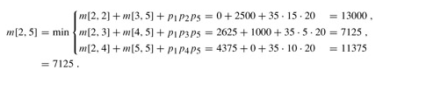
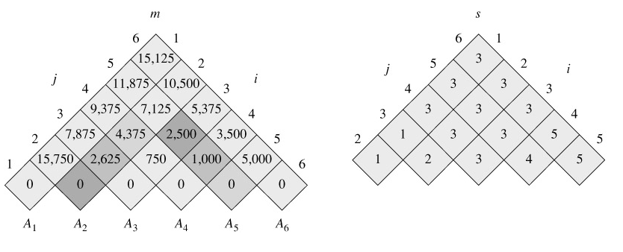

Slide 24
Print optimal parenthesis from s
Print-Optimal-Parens (s, i, j)
if i=j
then print “A”i
else print “(“
Print-Optimal-Parens (s, i, s[i,j])
Print-Optimal-Parens (s, s[i,j]+1, j)
print “)“

Slide 25
Optimal Parenthesization:
Optimal parenthesization is found from the previous Table.
Answer is ((A1(A2A3))((A4A5)A6))

